Slide 1
Presentation title slide
Utilising the World Risk Poll: Analysing predictors of risk perception and preparedness to develop effective weather risk communication
Andrea L. Taylor
a.l.taylor@leeds.ac.uk
Sarah Jenkins, Barbara Summers, Jack Thompson, Yim Ling Siu, Suraje Dessai

Slide 2
This project has been funded by the Lloyds Register Foundation as part of the Turning the World Risk Poll into Action scheme.
Lloyd’s Register Foundation invests £2 million in new projects to put World Risk Poll into action - The Lloyd's Register Foundation World Risk Poll (lrfoundation.org.uk)

Slide 3
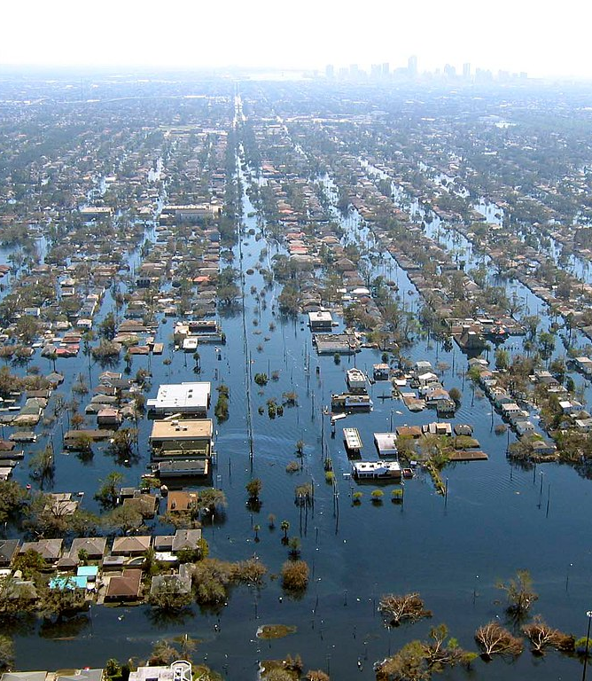
Text hierarchy and formatting information slide
“Over the past 50 years, there were more than 11 000 reported weather, climate and water-related disasters, resulting in just over 2 million deaths and US$ 3.64 trillion in economic losses.”
World Meteorological Organisation (2023)
Image: Katrina-new-orleans-flooding3-2005 - Flood - Wikipedia

Slide 4
Text hierarchy and formatting information slide
A changing climate means that the frequency and severity of weather-related disasters will increase in many regions.
Developing effective early warning communication is critical to reducing harm to people, property and infrastructure.
To do so we need to understand the current drivers of public weather and climate risk perception and preparedness.

Slide 5
Text hierarchy and formatting information slide
The Lloyds Register Foundation’s World Risk Poll (WRP)
Conducted in 2019, 2021 and 2023 by Gallup
Over 100,000 participants across more than 190 countries
Items cover…
Demographics (age, gender, education, urban vs rural)
Climate and weather risk perception
Risk preparedness behaviour
Beliefs about governmental preparedness
Trust in agencies/sources
Lloyd's Register Foundation World Risk Poll (lrfoundation.org.uk)

Slide 6
Text hierarchy and formatting information slide
Goal: Reducing harm from disasters through better early warning communication
Phase 1: Assess the predictors of risk perception and preparedness
Multi-level analyses of WRP 2019, 2021 & 2023 Integrating further data sources.
Phase 2: Select focal countries
Use Phase 1 analysis and input from practitioners in operational weather services and disaster risk reduction to select an indicative set of 4-5 countries
Phase 3: Develop and test weather warning comms in focal countries
Develop and experimentally test weather warning messaging in focal countries
Phase 4: Test hypotheses in 2025 WRP
Test hypotheses developed in Phases 1, 2 and 3 with the 2025 WRP

Slide 7
Text hierarchy and formatting information slide
Standard approaches to assessing predictors of risk perception and preparedness work when the relationship is the same in all countries
Country 1
Country 2
Experience
Preparedness
Experience
Preparedness
Positive
Positive

Slide 8
Text hierarchy and formatting information slide
But what if this isn’t the case?
Country 1
Country 2
Experience
Preparedness
Experience
Preparedness
Positive
Negative

Slide 9
Text hierarchy and formatting information slide
Predicting risk perception and preparedness
Several factors have been linked to risk perception and preparedness (e.g. experience, education, trust in authorities).
Which generalisable predictors of risk perception and preparedness?
What factors are country/context specific predictors?
Better understanding the latter in may help us to develop better warning communications.
By using a multi-level approach that accounts for country-level as well as individual-level differences we can gain a clearer picture.

Slide 10
Text hierarchy and formatting information slide
Integrating country level information on…
Disasters (EMDAT)
Governance (World Governance Indicators, Fragile States Index)
Wealth inequality (GINI index)
Climate risk (INFORM, ND GAIN)

Slide 11
National government well prepared to deal with disasters?
Experience of severe weather events
No-Yes
Preliminary analyses are already showing that the relationship between reported severe weather experience and beliefs about governmental preparedness differs between countries

Slide 12
Text hierarchy and formatting information slide
National government well prepared to deal with disasters?
Experience of severe weather: No-Yes

Slide 13
Text hierarchy and formatting information slide
Summary points
Developing effective multi-hazard early warning systems requires an understanding of the predictors of risk preparedness.
Our early findings show that there is high variability between countries in terms of the relationship between reported experience of disasters and perceived national level preparedness.
Through continuing to explore these in more detail we will identify a set of 4-5 focal countries with different characteristics.
We are seeking input on this process from the wider disaster risk reduction and MHEWS community.

Slide 14
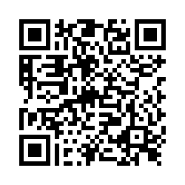
Text hierarchy and formatting information slide
Thank you
Questions, comments and points for consideration welcome
https://leedsubs.eu.qualtrics.com/jfe/form/SV_5hDFxEF2OVdR5YO

